Slide 1

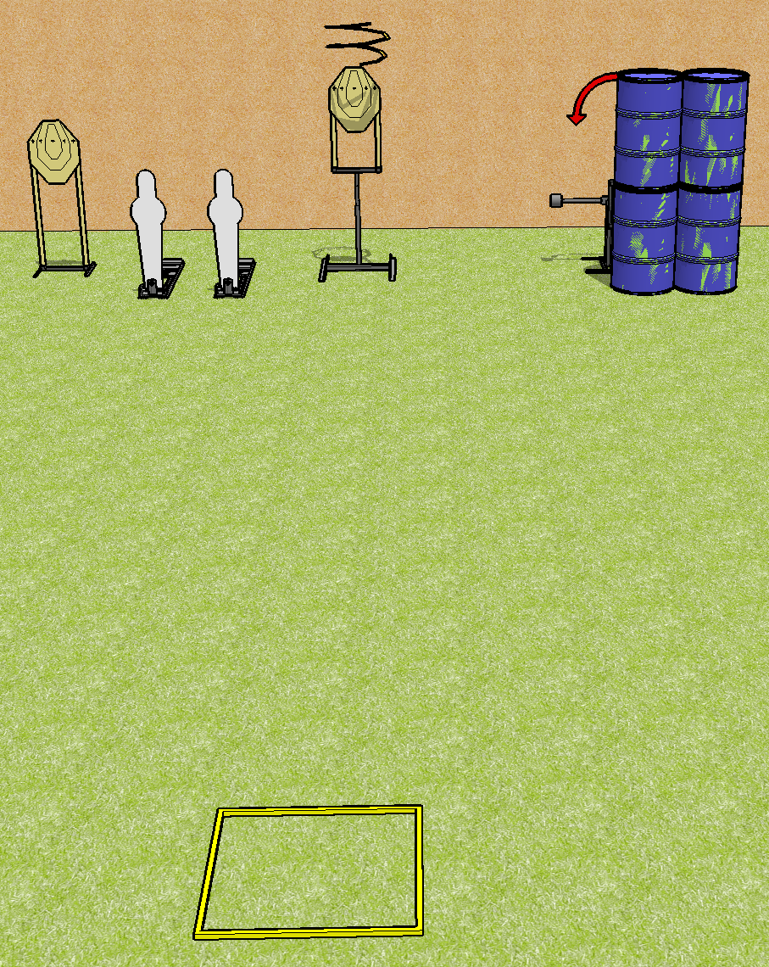
 | Dothan Practical Shooters – USPSA Match Just For Mike Course Designer : Drew Coleman Bay: B4
Round Count 8 rounds 3 IPSC, 2 pepper poppers
Equipment List Drop turner + swinger + activator Shooting box

Slide 2
Just for Mike
Written Stage Briefing
Scoring: Comstock Rounds: 8
Targets: 3 IPSC, 2 steel
Handgun start position: inside the shooting area, facing uprange, wrists above shoulders. Handgun is loaded and holstered.
PCC start position: inside the shooting area, wrists above shoulders. Loaded carbine is held with both hands, safety on.
Stage Procedure: on the audible start signal, engage targets as they become available from within the shooting area. P2 activates the drop turner and the swinger. The drop turner is a disappearing target and the swinger remains visible at rest.
Appendix A3, Facing uprange: Face and feet pointing directly (180 degrees) away from the backstop with shoulders and hips square to the backstop. A natural, "toes out" stance is acceptable and meets the standard of feet pointing directly away from the backstop, as long as both feet do not point in the same direction, and the rest of the position requirements are satisfied.

